Slide 1

ELECTRICITY BILLIING SYSTEM
JAKKAM PRAMOD KUMAR
POOJA CHOWDARY
V.M.S ADITYA AKHIL

Slide 2
CONTENTS TO BE COVERED
INTRODUCTION
SDLC OF THE PROJECT
FEATURES INCLUDED IN THE PROJECT
CONCLUSION

Slide 3
Project analysis slide 2
Project Analysis
ANALYSIS
SPECIFICATION
PROJECT
IMPLEMENT
DESIGN
TESTING
DEVELOP

Slide 4
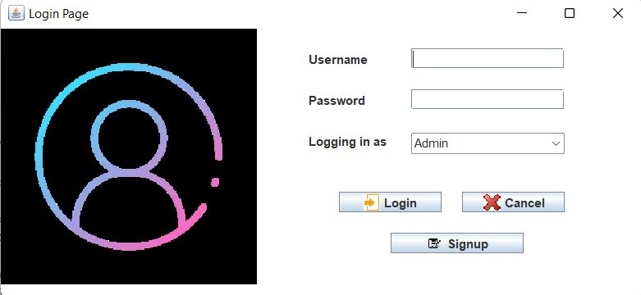

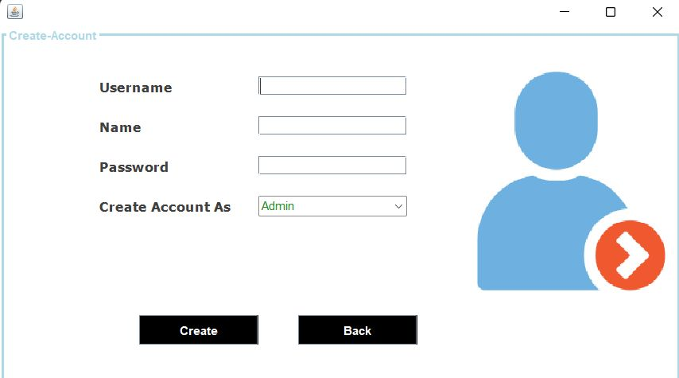
Project analysis slide 3
Project Analysis
LOGIN PAGE
LOGIN PAGE
Here is the login page of our electricity billing system, here customers can login into their accounts with their respective username and passwords, if any new user is try to login, he needs to signup with his details.
If any user given wrong credentials he will not be able to use the system.
There is an option of logging in as “Admin” or “Customer, it is for the Admins of the system, who can actually access all the functions in a system.
SIGNUP PAGE

Slide 5
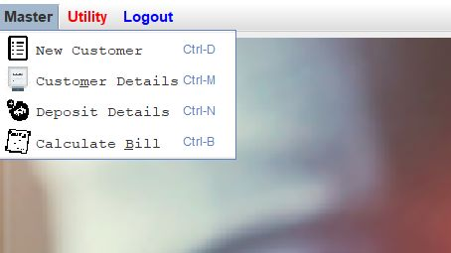
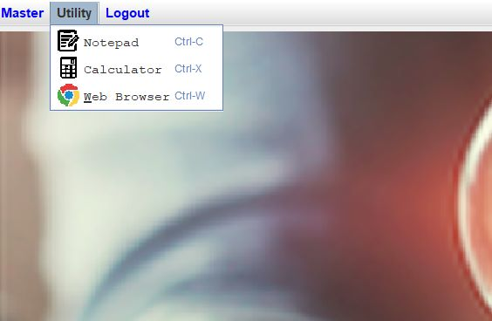
Project analysis slide 3
Project Analysis
MASTER FEATURE
In this Master Feature, Admin has the power to access multiple features such as “New Customer details, Old Customer details, Deposit details of the customer & Bill Generation details of the customer.
UTILITY FEATURE
In this Utility Feature, there are few features which consists of Save/Add the data in Notepad, Scientific calculator feature which can calculate the customer billing.

Slide 6
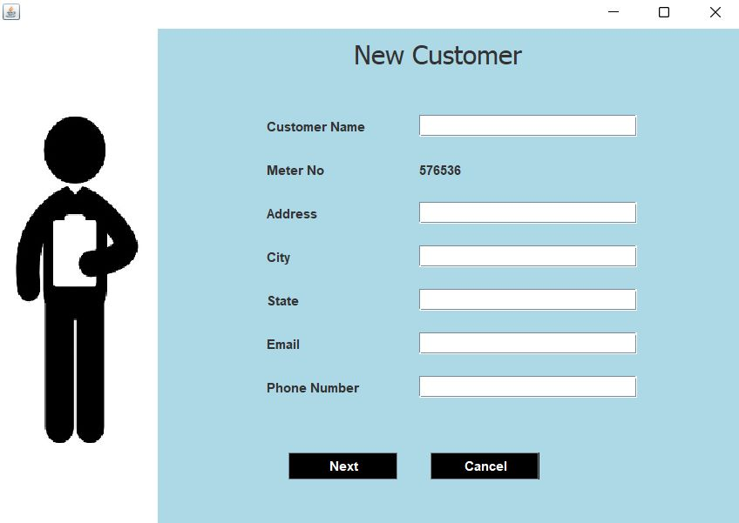
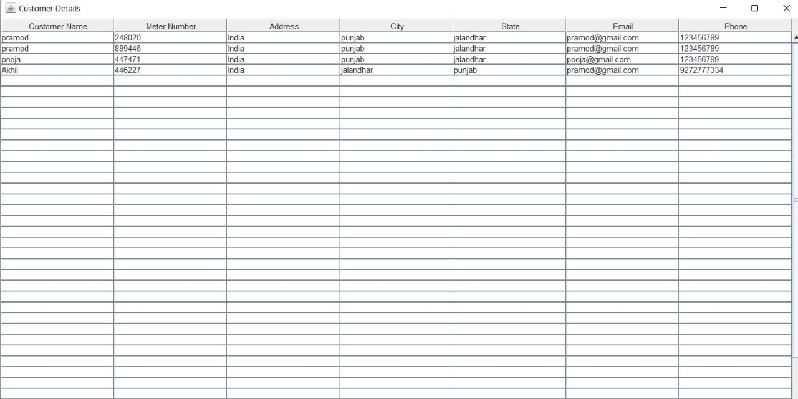
Project analysis slide 3
Project Analysis
New Customer Details
Here this is the interface for the New Customer to add him/her into the database. It contains the following information such as his name, city, address, email, phone number and the system will generate his/her meter no generally
Customer Details
Here is the customer details which is already stored in the database, it can access by the Admin, he can view , edit or manage the customer details.

Slide 7
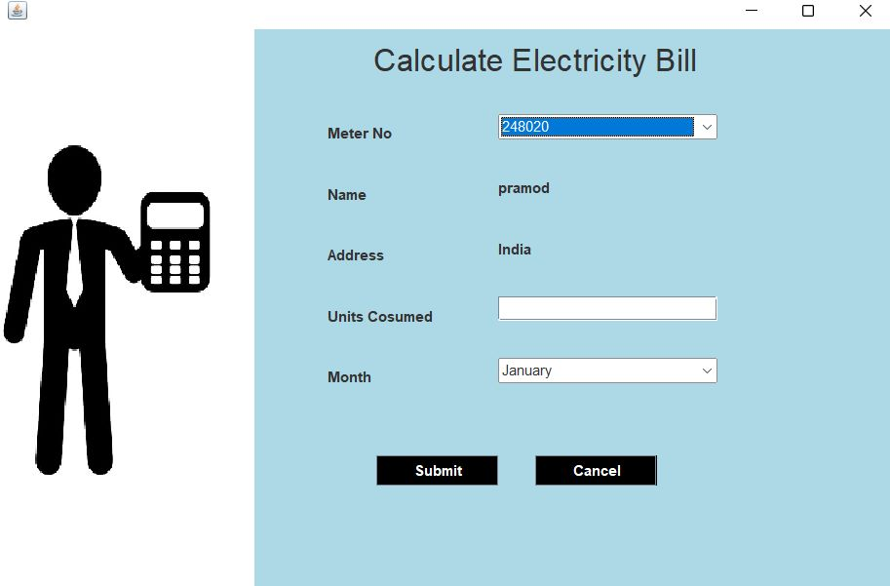
Project analysis slide 3
Project Analysis
Calculates the bill
Here is the interface/portal to calculate the electricity bill of the customers, it is done by the admin itself for the customers. By providing the details of meter no, units consumed and for which month we want to calculate, thus Admin can calculate the Electricity bill for the customers.

Slide 8
Thank You

